Slide 1

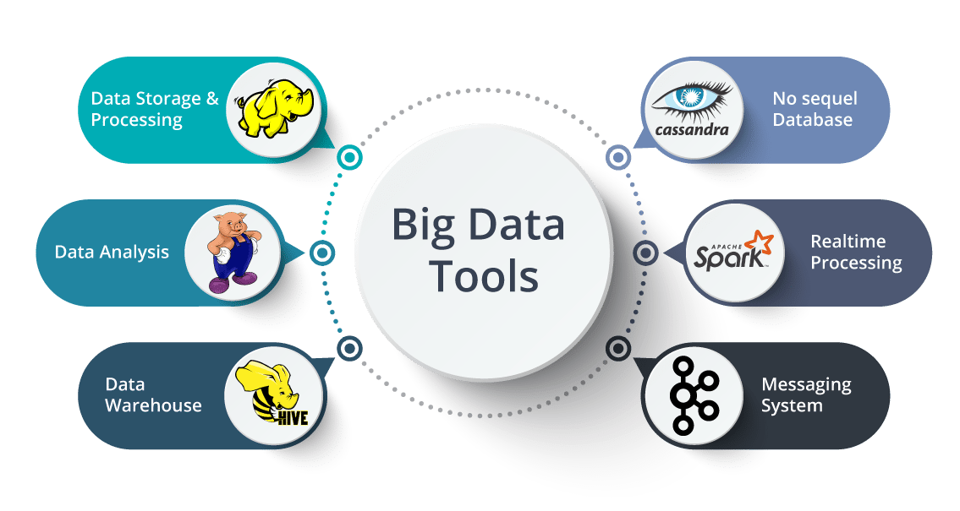
Big Data Storage and Processing MSc in Data Analytics CCT College Dublin
Apache HBase
Week 6
Lecturer: Dr. Muhammad Iqbal*
Email: miqbal@cct.ie

Slide 2
Agenda
Hadoop Ecosystem
Introduction to Column-oriented DBs
Relational Databases: Transaction Support
Relational & Non-relational Databases
Classification of Non-relational Databases
HBase & Architecture
Main components of HBase Architecture

Slide 3
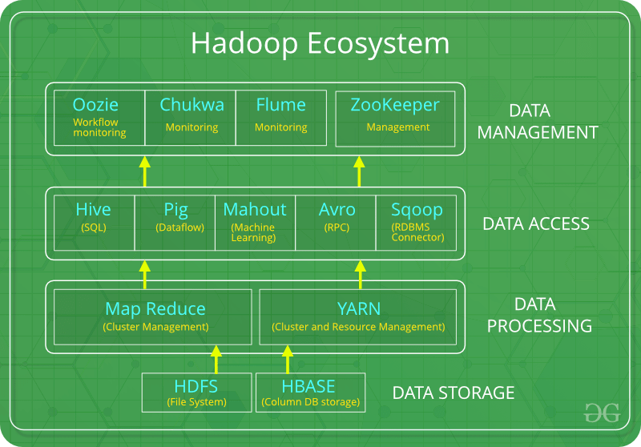
Hadoop Ecosystem
Hadoop Ecosystem is a platform which provides various services to solve the big data problems. It includes Apache projects and various commercial tools and solutions.
New Approach
Google
Amazon
Scalable Storage and Processing platforms based on commodity hardware
Implemented as an open-source Apache Hadoop project
The Hadoop Ecosystem
HDFS: Hadoop Distributed File System
YARN: Yet Another Resource Negotiator
MapReduce: Programming based Data Processing
Spark: In-Memory data processing
PIG, HIVE: Query based processing of data services
HBase: NoSQL Database
Mahout, Spark MLLib: Machine Learning algorithm libraries
Zookeeper: Managing cluster
Oozie: Job Scheduling
Notes:
Hadoop is difficult to program as it uses Java for data absorption.

Slide 4
Introduction to Column-oriented DBs
Recent Approaches
Access to data via
Column-oriented databases
Massively Parallel Processing databases
Column-Oriented Databases
Save data grouped by columns
Subsequent columns stored contiguously on disk
Good for analytical processing
Reduced I/O
Compression opportunities
Id | Fld1 | Fld2 | Fld3
1675765 | <sdhj>hgasd** | 154354UU | *&^jjjjGHF
7868733 | `<jljlj><>m,j | 83899HHY | ))((JNNNk
9877388 | <iuiuoun<>> | ()*8829829 | YIUHbh+_’
Id | 1675765 | 7868733 | 9877388
Fld1 | <sdhj>hgasd** | `<jljlj><>m,j | <iuiuoun<>>
Fld2 | 154354UU | ()*8829829 | ()*8829829
Fld3 | *&^jjjjGHF | ))((JNNNk | YIUHbh+_’
HBase
Uses an on-disk column storage format
Provides key-based access to a specific cell of data or a sequential range of cells
Notes:
Reduced I/O is one of the primary reasons for this new layout, but it offers additional advantages playing into the same category: since the values of one column are often very similar in nature.
Specialized algorithms, for example, delta and/or prefix compression—selected based on the type of the column can yield huge improvements in the compression ratios.
HBase stores data on disk in a column-oriented format and HBase excels at providing key-based access to a specific cell of data, or a sequential range of cells.

Slide 5
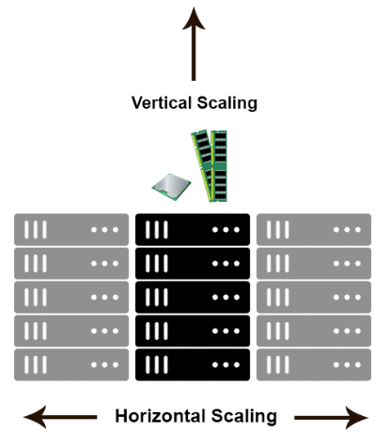
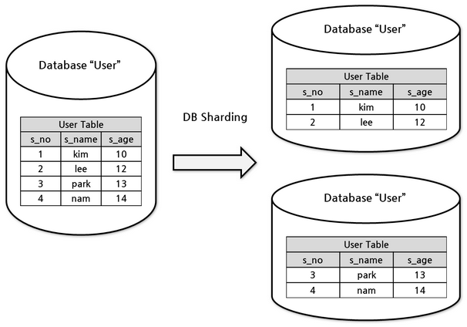
Relational Databases Issues
Difficulties faced to fulfil the demand for recent storage requirements
Relational databases typically normalised (Strict structure)
Transaction semantics: ACID properties provide strong consistency
Slave databases can be added to cope with initial increases in demand for data access services
System may be scaled vertically
If SQL JOINs suffer performance degradation, denormalisation may be entertained
Stored Procedures/ Secondary Indexes may be abandoned
Data may be sharded
Notes:
Horizontal scaling means that you scale by adding more machines into your pool of resources whereas Vertical scaling means that you scale by adding more power (CPU, RAM) to an existing machine.
Referential integrity refers to the relationship between tables. Because each table in a database must have a primary key, this primary key can appear in other tables because of its relationship to data within those tables. When a primary key from one table appears in another table, it is called a foreign key .

Slide 6
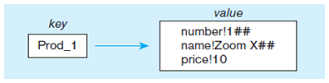
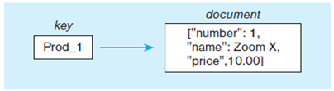
NoSQL Databases Classification
Key-Value Stores
Simple data model
Map/ Dictionary
Clients can put, request (and delete) values by key
Amazon DynamoDB, Redis and Riak
Document Oriented Databases
Stores data as documents
Documents encapsulate/ encode data
Allows encapsulation of key/ value pairs within document.
Values may be strings, booleans, numerics, lists etc.
XML, JSON, BSON, PDF
No strict schema
MongoDB is an example
Notes:
BSON stands for Binary Javascript Object Notation. It is a binary-encoded serialization of JSON documents. BSON has been extended to add some optional non-JSON-native data types, like dates and binary data.
Portable Document Format (better known by the abbreviation PDF)
XML stands for extensible markup language.

Slide 7
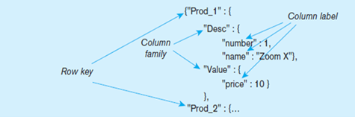
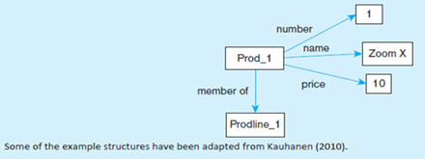
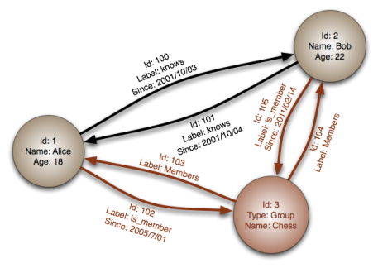
NoSQL Databases Classification
Column-oriented Database
Rows and columns, Distribution of data based on both key values (records) and columns, using “column groups/ families”.
Graph-oriented Database
Maintain information regarding the relationships between data items. Nodes with properties, Connections between nodes (relationships) can also have properties.

Slide 8
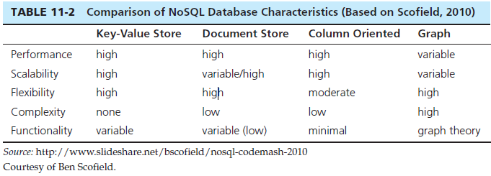
NoSQL Databases Comparison
https://nosql-database.org/
NoSQL Examples
Redis – Key-value store DBMS
MongoDB – Document store DBMS
Apache HBase – Column store DBMS
Neo4j – Graph DBMS
Notes:
Key: "user123"
Value: {
"name": "Alice Johnson",
"email": "alice@example.com",
"registration_date": "2023-01-15"
}
Key: "user456"
Value: {
"name": "Bob Smith",
"email": "bob@example.com",
"registration_date": "2023-02-20"
}
Key: "user789"
Value: {
"name": "Charlie Brown",
"email": "charlie@example.com",
"registration_date": "2023-03-10"
}

Slide 9
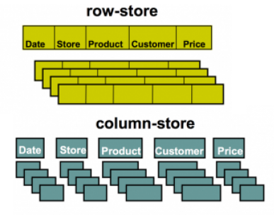
NoSQL Databases Column Oriented Databases
Stores data as sections of columns rather than as rows
Stores all values of a column together
then the values of the next column together
and so on
Good for applications performing analysis of data
Good compressibility
Examples: HBase and Cassandra
We will look at HBase as an example

Slide 10

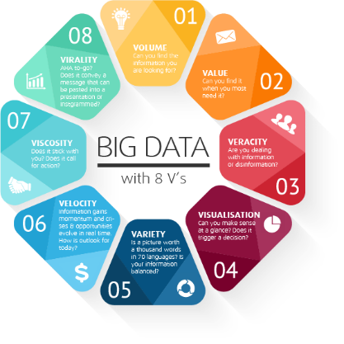
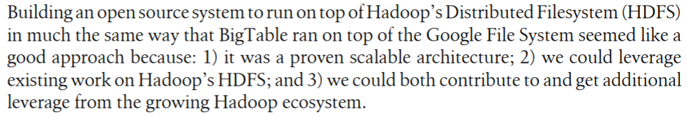
HBase
The HBase tale began in 2006 when Powerset, a San Francisco-based firm, set out to create a Web-based natural language search engine.
The index size was significantly larger than usual.
The datastore they had constructed to accommodate the index intermediaries and the webcrawl on top of Amazon Web Services was breaking under the load. They were searching for a different solution.
Powerset's head of engineering at the time, Chad Walters, offers the following reflections on the event

Slide 11
Hbase The Dawn of Big Data
Systems like Hadoop enable them to gather and process petabytes of data, and process using new machine learning algorithms to meet the business objectives.
The implementation of scalable storage and processing system outside of Google as part of the open source Hadoop project: HDFS and MapReduce.
Hadoop excels at storing data of arbitrary, semi-, or even unstructured formats as well as also complements existing database systems of almost any kind.
This makes analysis easy and fast, but the users also need access to the final data, not in batch mode but using random access.
RDBMS are the most prominent, but there are also quite a few specialized variations and implementations, like object-oriented databases. Most RDBMS strive to implement Codd’s 12 rules, which forces them to comply to very rigid requirements.

Slide 12
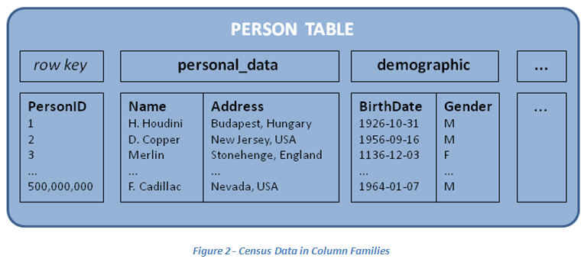
HBase Architecture
A column is the most basic unit.
One or more columns form a row. Each row can have many Columns in each column family.
Each row is addressed by a row key.
A number of rows form a table. Tables have a fixed number of Column Families.
Each column has a set of values and each with a timestamp.
Each rowkey:columnfamily:column:timestamp combination represents coordinates for a Cell.
Tables, Rows, Columns, and Cells
Each record is divided into Column Families
Each row has a Key
Each column family consists of one or more Columns

Slide 13
HBase Architecture Tables, Rows, Columns, and Cells
Rows are sorted lexicographically by their row-key
Row-keys are compared at a binary level, byte by byte, from left to right
Provides something similar to a traditional primary key
Row-keys are any array of bytes
Columns are grouped into column families
Provide semantic boundaries between different sets of columns
Can be used to control storage features (e.g., compression)
All columns in a column family are stored together in the same low-level storage file called a Hfile
Columns are referenced as family:qualifier
Defined at create time – should not be changed
Notes:
In mathematics, the lexicographic or lexicographical order (also known as lexical order, dictionary order, alphabetical order or lexicographic(al) product) is a generalization of the way words are alphabetically ordered based on the alphabetical order of their component letters.

Slide 14
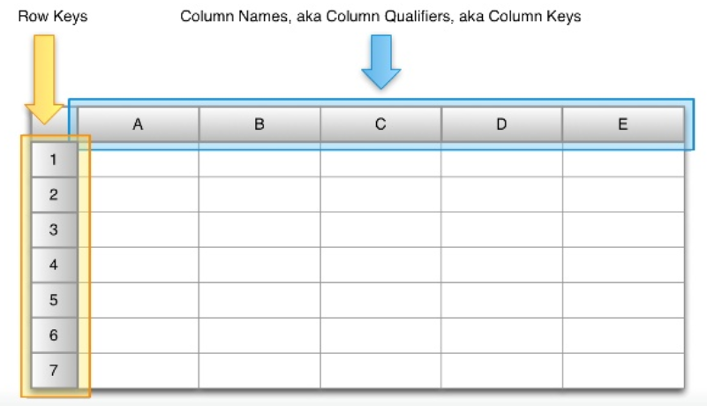
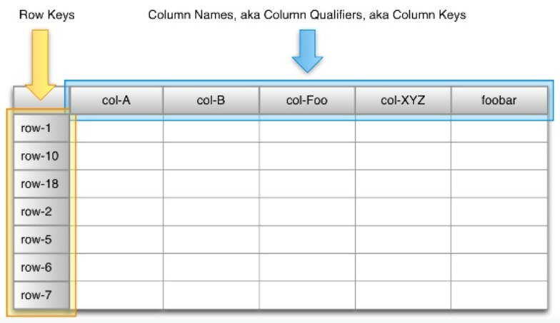
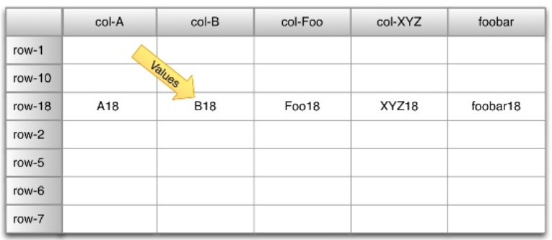
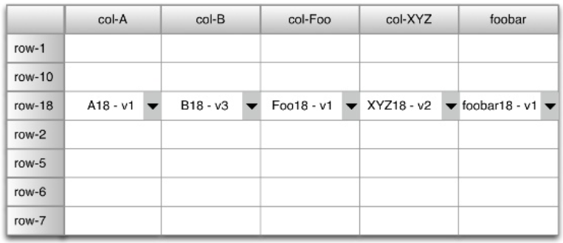
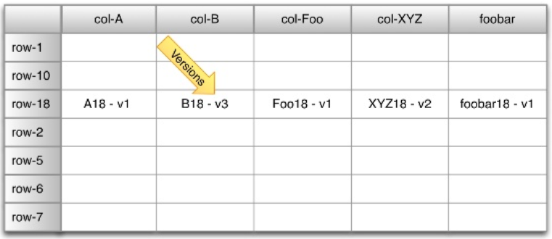
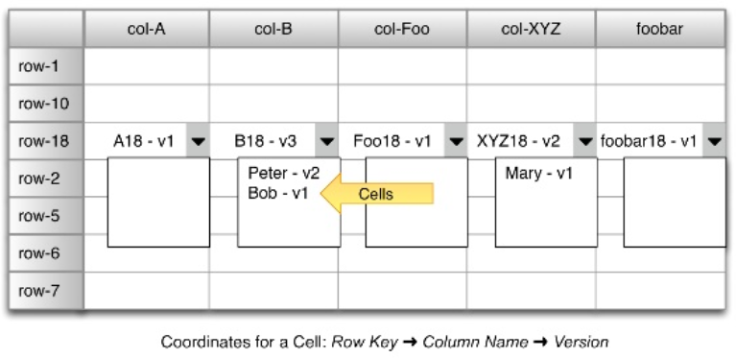
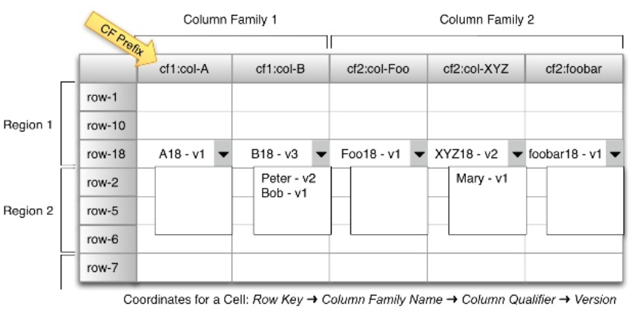
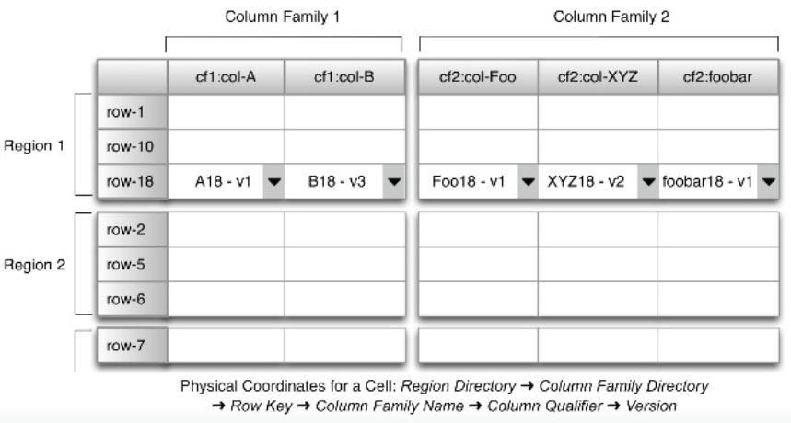
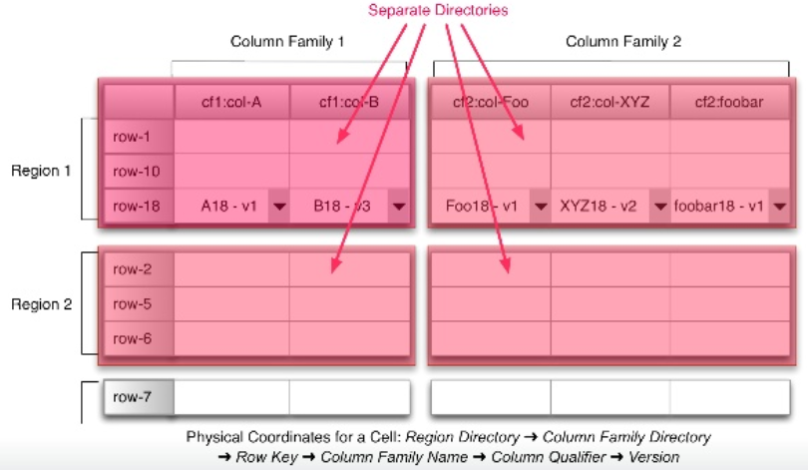
HBase Architecture

Slide 15
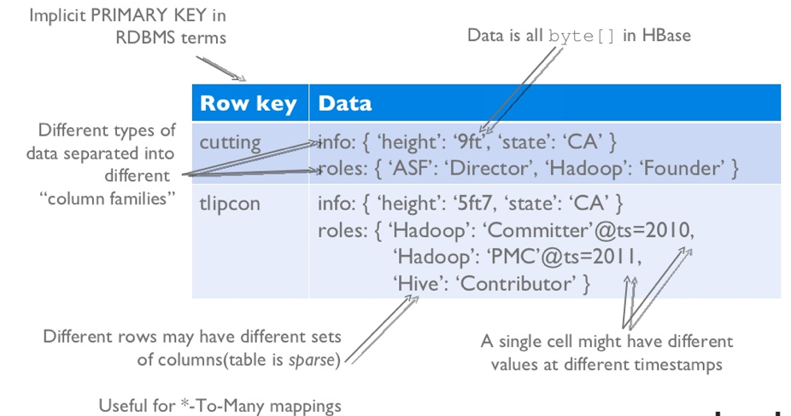
HBase Architecture Tables, Rows, Columns, and Cells
A cell is either implicitly timestamped by the system or a timestamp can also be provided by the user
Different versions of a cell are stored in decreasing timestamp order
Generally, most recent data required first
Number of versions or timespans for which to maintain versions can be configured
Access to row data is atomic
No guarantee or transactional features that span multiple rows or multiple accesses across tables
A Column Family is a group of related columns
All columns must be in a column family
Each row can have a completely different set of columns for a column family
Notes:
A timestamp is a sequence of characters or encoded information identifying when a certain event occurred, usually giving date and time of day, sometimes accurate to a small fraction of a second.

Slide 16
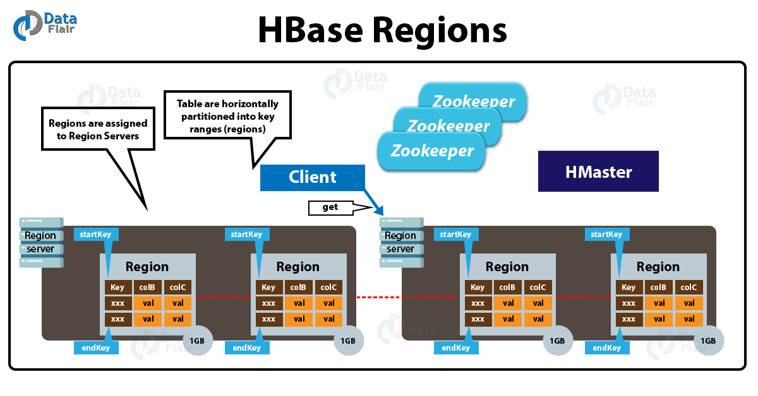
HBase Architecture Regions
The basic unit of scalability and load balancing in HBase is a region
A region is essentially contiguous ranges of rows stored together
The system will dynamically split them when they exceed a certain threshold size limit - autosharding
Regions may also be merged
Reduce number of files
Regions may be spread across many physical servers
Distributes load and increases scalability
Each region is served by exactly one region server
A region server can serve more than one region
Notes:
The default size of a region is 256MB, which we can configure as per requirement.

Slide 17
HBase Architecture Regions
Initially there is only one region for a table – however, when a limit is reached the region is split into two at the middle-key.
The default size of the region is 256 MB but it can be adjusted according to the requirements.
Typically 10 to 1000 regions per server with each region between 1GB and 2GB.
Rows
A
.
.
H
.
.
.
Q
.
.
.
.
Z
Region Server 1
Region Server 2
Region Server 3
Keys:[T-Z)
Table Logical View
Keys:[I-M)
Keys:[F-I)
Keys:[A-C)
Keys:[M-T)
Keys:[C-F)

Slide 18
HBase Architecture Storage API
Create / Delete tables and column families
Modify metadata
CRUD functionality
scan API
Single row atomic transactions (read-modify-write)
Integration with MapReduce framework
No specific domain language, such as SQL
Imperative programming
CRUD
get: retrieve an entire, or partial row (R)
put: create and update a row (CU)
delete: delete a cell, column, columns, or row (D)
Result get (Get get) throws IOException;
void put(Put put) throws IOException;
void delete(Delete delete) throws IOException;
Notes:
Imperative programming is a programming paradigm that uses statements that change a program's state. In much the same way that the imperative mood in natural languages expresses commands, an imperative program consists of commands for the computer to perform.

Slide 19
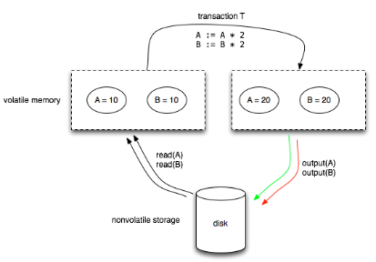
HBase Architecture File Storage
Data is stored in store files called HFiles
Persistent
Internally, files are sequences of blocks with a block index stored at the end
Index loaded when HFile is opened and kept in memory
Default block size is 64KB
Lookups can be performed with a single disk seek
Binary search of index followed by block read from disk
Store files typically stored in HDFS
Guarantees durability of data by writing changes across a configurable number of physical servers
Write-Ahead Logging is used
Commit-Log then memstore
Memstore flushed when full
Notes:
Persistent storage is any data storage device that retains data after power to that device is shut off. It is also sometimes referred to as non-volatile storage.
Write-ahead logging (WAL) is a family of techniques for providing atomicity and durability (two of the ACID properties) in database systems. The changes are first recorded in the log, which must be written to stable storage, before the changes are written to the database.

Slide 20
HBase Architecture File Storage
Store Files are immutable
When deleting key-value pairs, a delete marker is used to mask the actual values from reading clients.
Reading data involves a merge of what is contained in memstores and the data on disk.
Once the data in memory has exceeded a given maximum value, it is flushed as an HFile to disk.
Flushing causes more HFiles to be created
HBase uses compaction
Minor Compaction - triggered each time a memstore is flushed
Major Compaction - run about every 24 hours and merge together all store files into one
Notes:
Minor compactions: combine a configurable number of smaller HFiles into one larger HFile. You can tune the number of HFiles to compact and the frequency of a minor compaction. Minor compactions are important because without them, reading a particular row can require many disk reads and cause slow overall performance.
Major Compactions: reads all the Store files for a Region and writes to a single Store file.
Since flushing memstores to disk causes more and more HFiles to be created, HBase has a housekeeping mechanism that merges the files into larger ones using compaction. There are two types of compaction: minor compactions and major compactions. The former reduce the number of storage files by rewriting smaller files into fewer but larger ones, performing an n-way merge. Since all the data is already sorted in each HFile, that merge is fast and bound only by disk I/O performance. The major compactions rewrite all files within a column family for a region into a single new one. They also have another distinct feature compared to the minor compactions: based on the fact that they scan all key/value pairs, they can drop deleted entries including their deletion marker. Predicate deletes are handled here as well—for example, removing values that have expired according to the configured time-to-live or when there are too many versions.

Slide 21
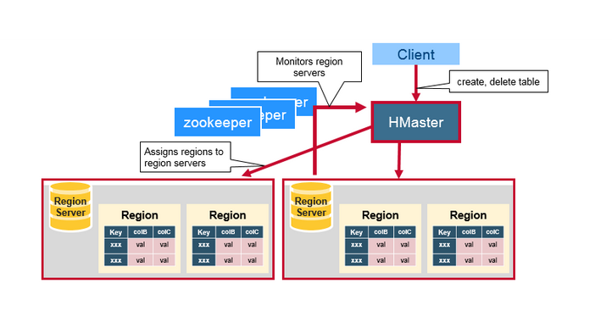
HBase Architecture Main Components
The client library
One master server
Many region servers
The master is responsible for assigning regions to region servers and uses Apache Zookeeper
Reliable, highly available, persistent, distributed coordination service
Necessary component for HBase operation
Notes:
ZooKeeper is a centralized service for maintaining configuration information, naming, providing distributed synchronization, and providing group services. All of these kinds of services are used in some form or another by distributed applications.

Slide 22
HBase Architecture Main Components
The master server is also responsible for handling load balancing of regions across region servers, to unload busy servers and move regions to less occupied ones.
The master is not part of the actual data storage or retrieval path.
It negotiates load balancing and maintains the state of the cluster, but never provides any data services to either the region servers or the clients, and is therefore lightly loaded in practice.
In addition, it takes care of schema changes and other metadata operations, such as creation of tables and column families.
HBase
API
Master
Region Servers
HFile
Memstore
WAL
HDFS
ZooKeeper
Notes:
WAL: Write Ahead Log provides consistent put/delete operations. All operations are written to it before making change in region. If something goes wrong with the region server we can repair information from WAL.

Slide 23
HBase Architecture Main Components
Region servers
Region servers are responsible for all read and write requests for all regions they serve, and also split regions that have exceeded the configured region size thresholds.
Clients communicate directly with them to handle all data-related operations.
HBase
API
Master
Region Servers
HFile
Memstore
WAL
HDFS
ZooKeeper
Notes:
WAL: Write Ahead Log provides consistent put/delete operations. All operation is written to it before making change in region. If something goes wrong with the region server we can repair information from WAL.

Slide 24
Resources/ References
Lars George, 2011, HBase The Definitive Guide, O’Reilly Publishing.
Apache HBase Primer, Deepak Vohra, Apress, November 2016.
Hadoop with Python, Zach Radtka; Donald Miner, O'Reilly Media, Inc., 2015.
Lublinsky B., Smith K. T. and Yakubovich A 2013, Professional Hadoop Solutions, Wrox [ISBN: 13:978-11186]
Holmes A 2012, Hadoop in Practice, Manning Publications [ISBN: 13:978-16172]
McKinney W. 2012, Python for Data Analysis, O'Reilly Media [ISBN: 13: 978-14493]
Some images are used from Google search repository (https://www.google.ie/search) to enhance the level of learning.
Copyright Notice The following material has been communicated to you by or on behalf of CCT College Dublin in accordance with the Copyright and Related Rights Act 2000 (the Act). The material may be subject to copyright under the Act and any further reproduction, communication or distribution of this material must be in accordance with the Act. Do not remove this notice

